Slide 1
Java Course Introduction
Università di Modena e Reggio Emilia
Prof. Nicola Bicocchi (nicola.bicocchi@unimore.it)

Slide 2
What?
Object-oriented programming (OOP) is a programming paradigm based on the concept of class objects, which can contain both data and code
Data in the form of variables (known as attributes)
Code in the form of functions (known as methods)
Java and Python are among the most prominent languages in the field

Slide 3
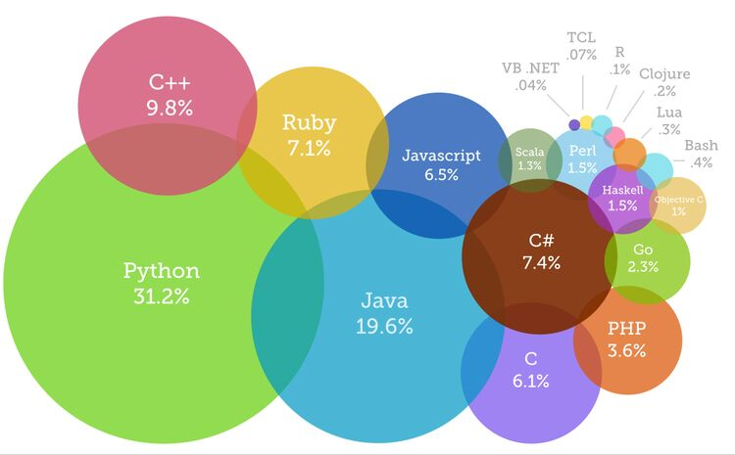
Why?
OOP followed Procedural Programming due to serious limitations affecting large-scale projects
OOP is the de facto standard for industrial software
Building modern applications almost always requires OOP languages such as Java, Python, C#, C++

Slide 4
How?
https://github.com/nbicocchi
https://www.jetbrains.com/idea/
https://www.anaconda.com/
https://www.jetbrains.com/pycharm/

Slide 5
When?
Thursday 9.15 - 10.45
Thursday 11.15 - 13.00
Friday 16 - 19 (Lab)

Slide 6
Exam?
Oral examination about OOP and the Java and Python languages (short written exercises might be used)
Discussion about the structure and engineering choices of the home project written in Java or Python (1000-5000 SLOC)

Slide 7
IntelliJ Idea Configuration

Slide 8
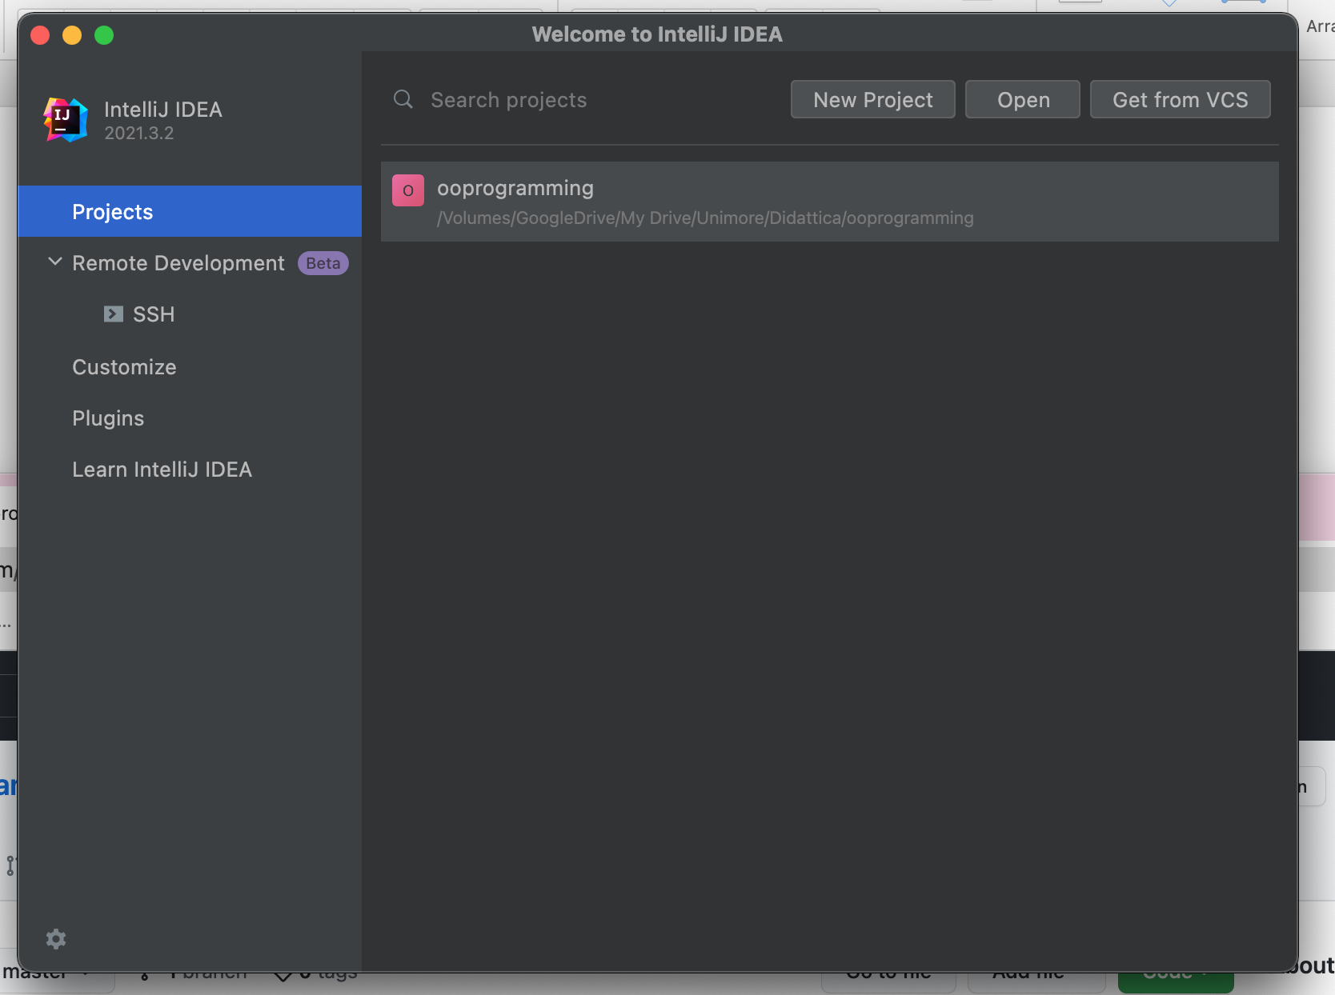
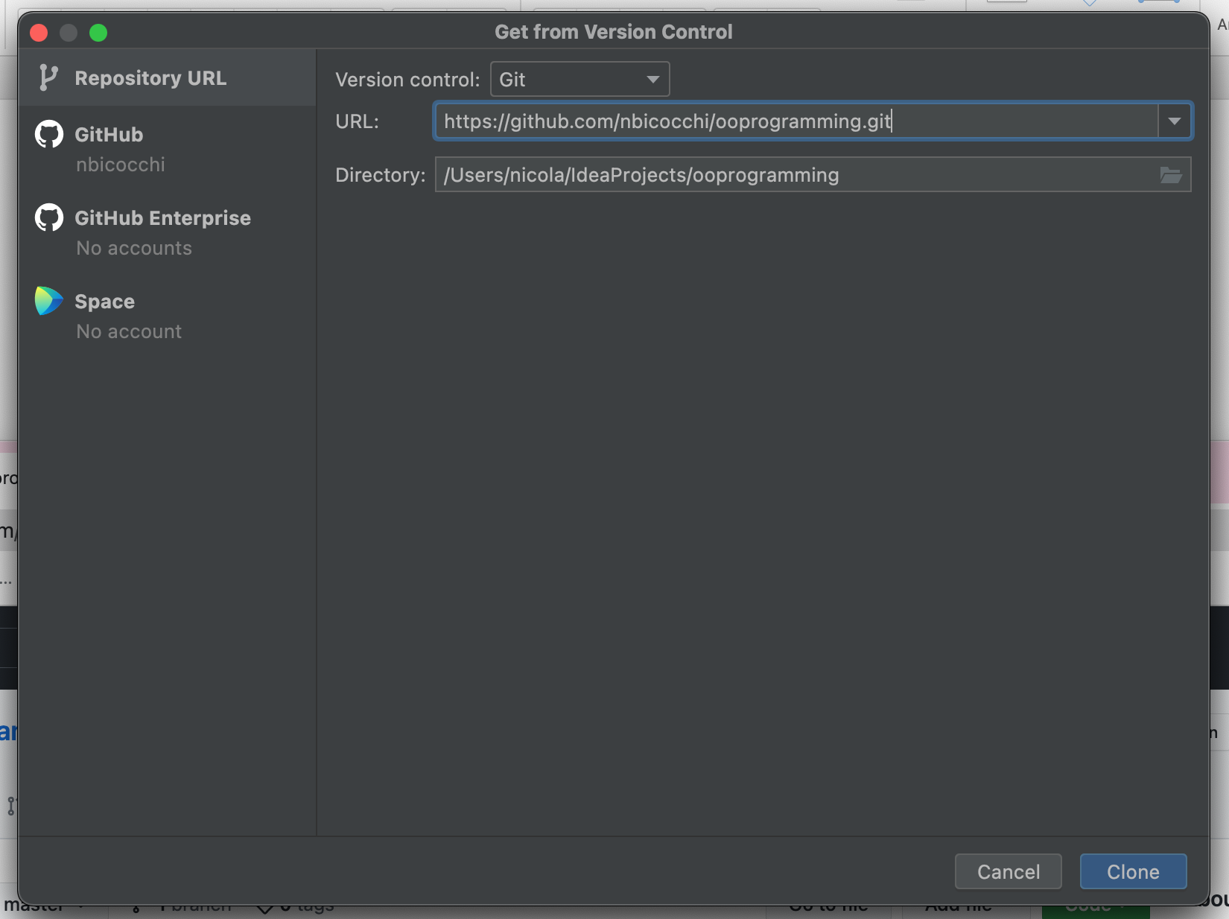
Welcome to IntelliJ Idea

Slide 9
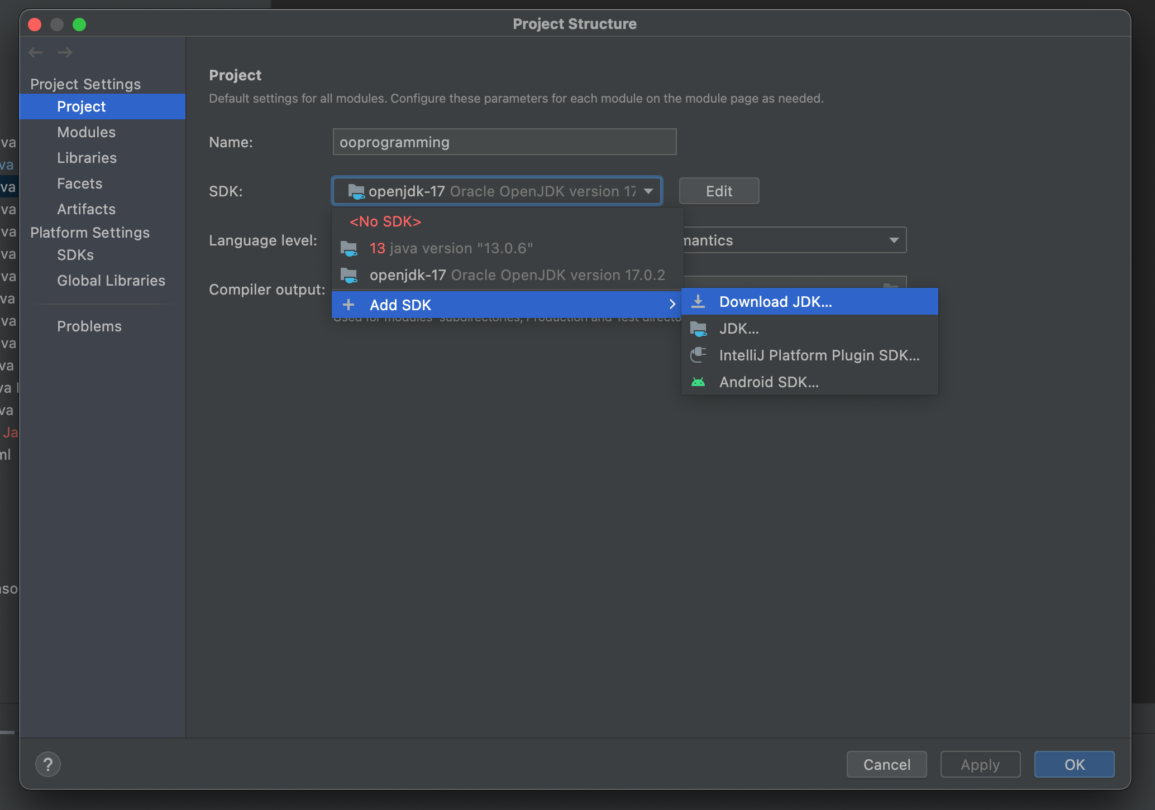
File -> Project Structure
Download openjdk-17
Select SDK: openjdk-17

Slide 10
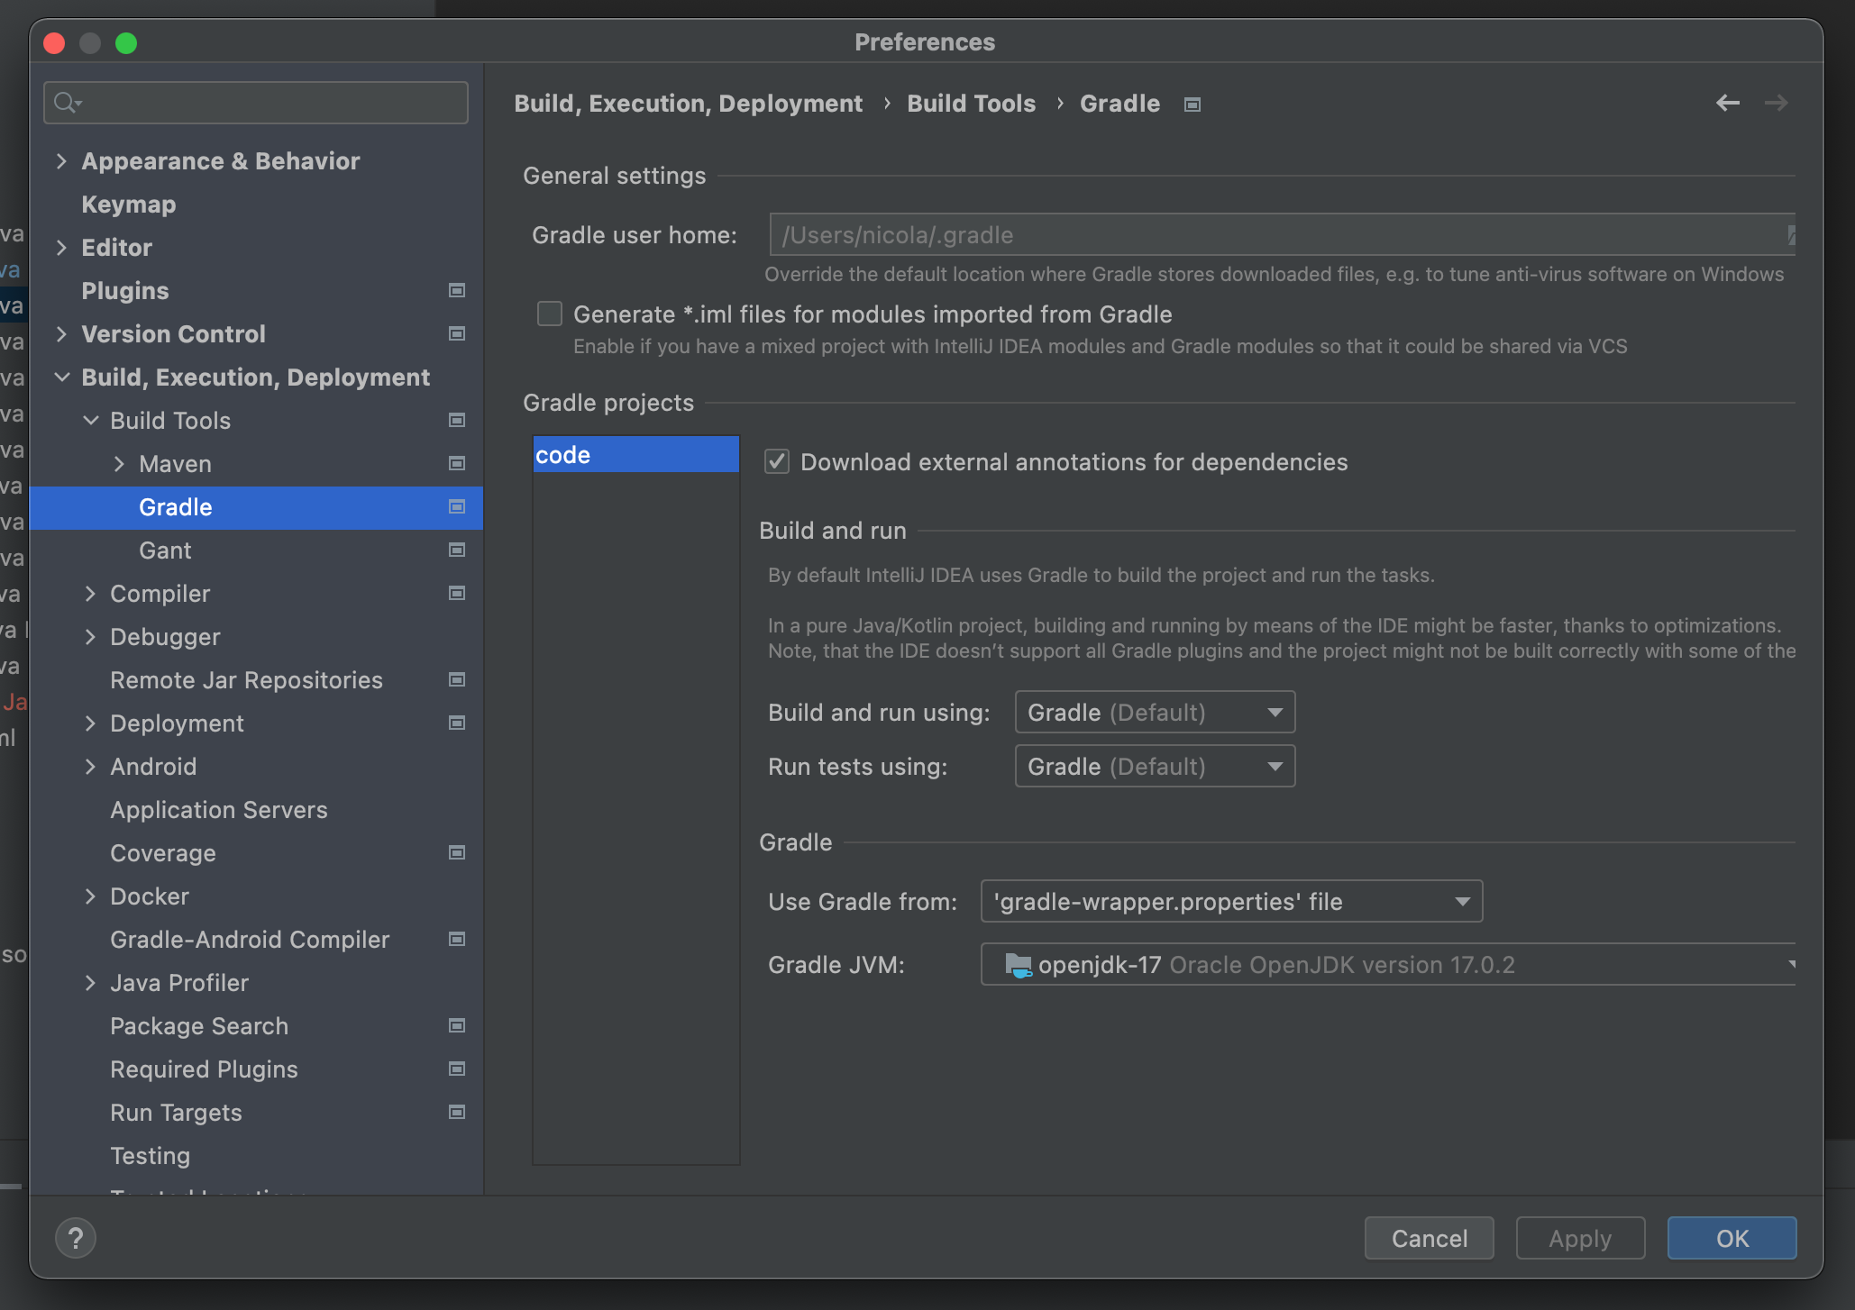
Preferences -> Build, Execution, Deployment -> Gradle
Build and run using: Gradle
Run tests using: Gradle
Gradle JVM: openjdk-17

Slide 11
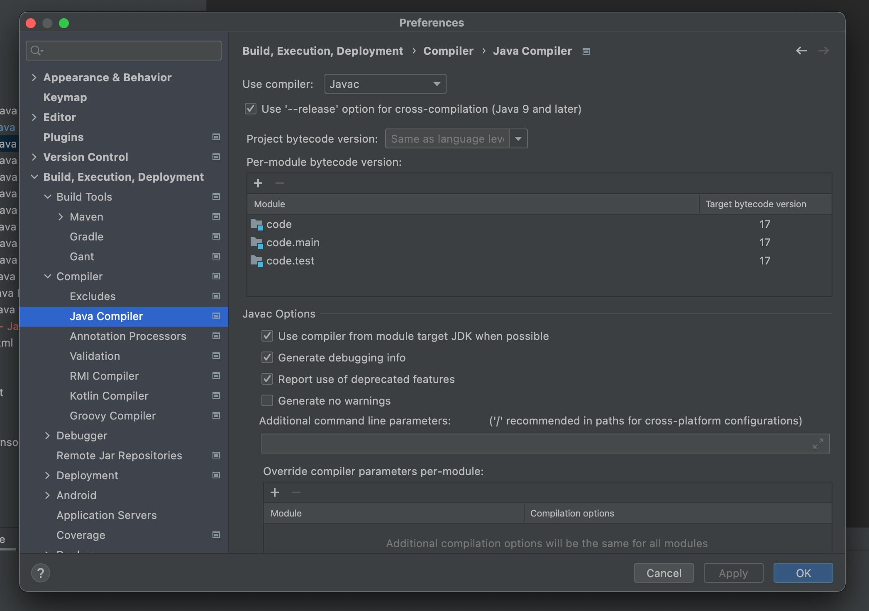
Preferences -> Build, Execution, Deployment -> Java Compiler
Use compiler: Javac
Target bytecode version: 17

Slide 12
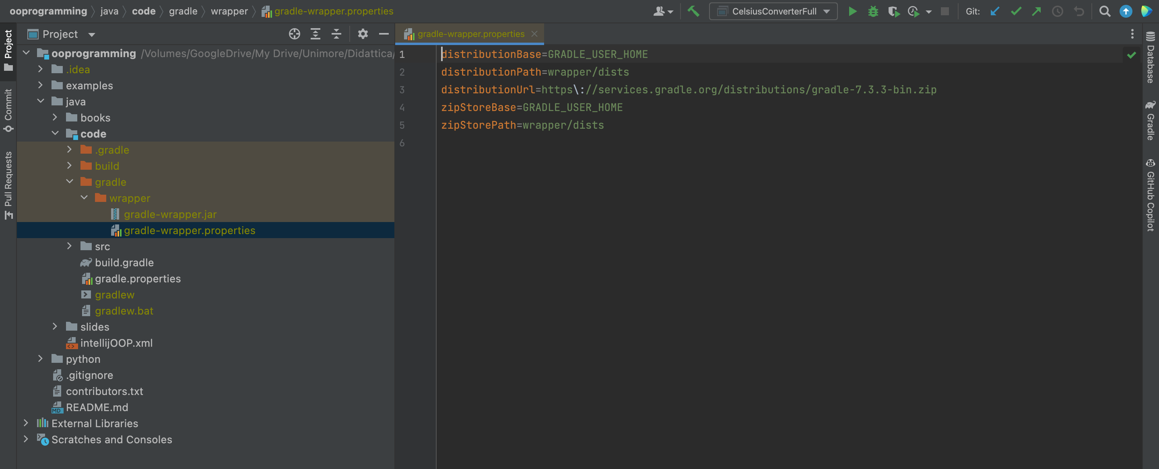
Preferences -> Build, Execution, Deployment -> Java Compiler

Slide 13
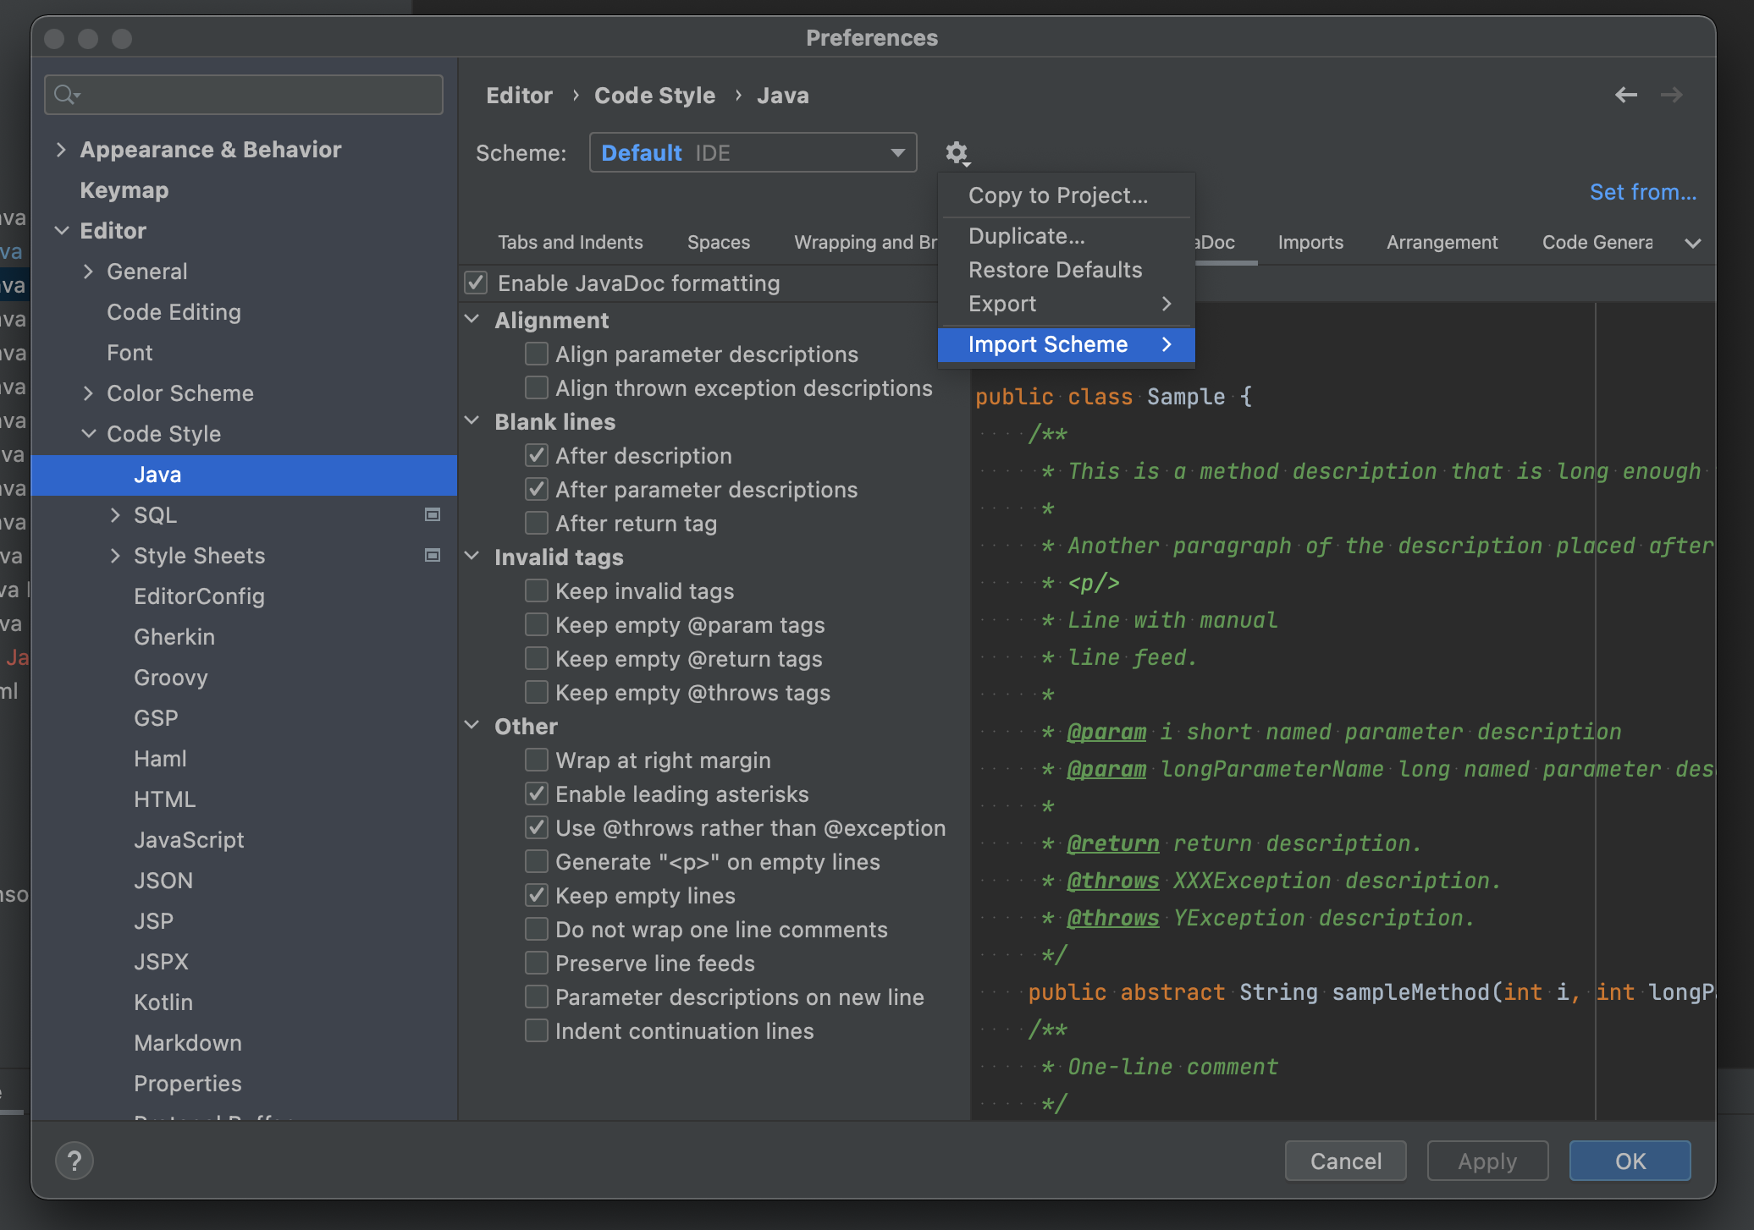
Preferences -> Editor -> Code Style -> Java
Import intellijOOP.xml (located in ooprogramming/java)

